Slide 1

An Intro to Machine Learning
Golnaz Sahebi
golnaz.sahebi@turkuamk.fi
2023

Slide 2
Main Challenges of Machine Learning
Insufficient Quantity of Training Data
Non-representative Training Data
Poor-Quality Data
Irrelevant Features
Overfitting the Training Data
Underfitting the Training Data
Since your main task is to select a learning algorithm and train it on some data, the two things that can go wrong are “bad algorithm” and “bad data.” Let’s start with examples of bad data.

Slide 3
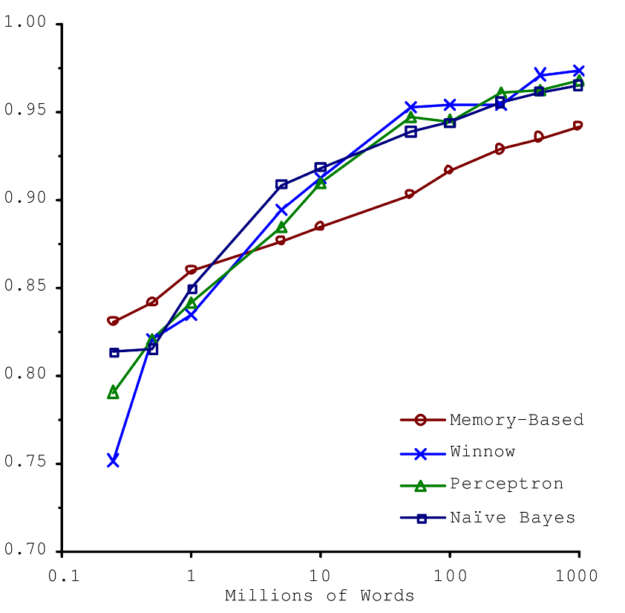
Insufficient Quantity of Training Data
For very simple problems you typically need thousands of examples, and for complex problems such as image or speech recognition you may need millions of examples.
Test Accuracy
The importance of data versus algorithm

Slide 4
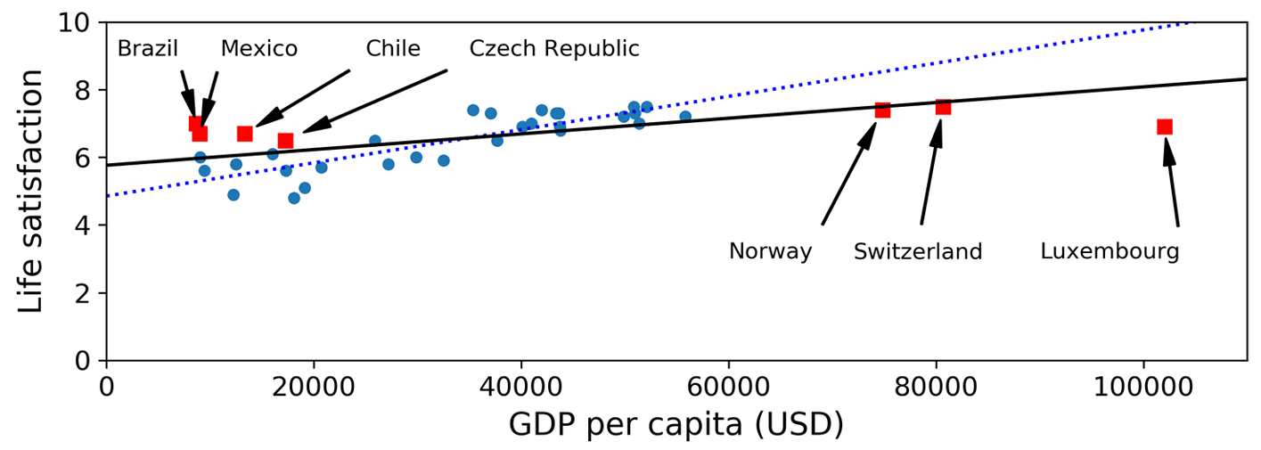
Non-representative Training Data
If you train a linear model on the new data (containing red points), you get the solid line, while the old model is represented by the dotted line. As you can see, not only does adding a few missing countries significantly alter the model, but it makes it clear that such a simple linear model is probably never going to work well

Slide 5
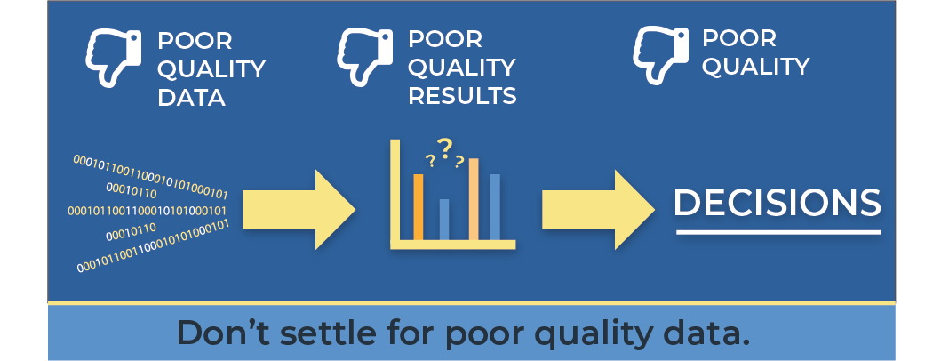
Poor-Quality Data
Obviously, if your training data is full of errors, outliers, and noise (e.g., due to poor quality measurements), it will make it harder for the system to detect the underlying patterns, so your system is less likely to perform well

Slide 6
Irrelevant Features
Your system will only be capable of learning if the training data contains enough relevant features and not too many irrelevant ones.
Garbage in, garbage out
Solution => Feature engineering

Slide 7
Features Engineering
Feature engineering is a machine learning technique that leverages data to create new variables that aren’t in the training set. It can produce new features for both supervised and unsupervised learning, with the goal of simplifying and speeding up data transformations while also enhancing model accuracy.
Feature engineering consists of various process such as:
Feature Creation
Feature Selection
Transformations
Feature Extraction
Exploratory Data Analysis

Slide 8
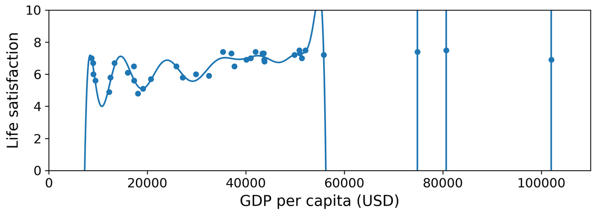
Overfitting the Training Data
Overfitting happens due to several reasons, such as:
• The training data size is too small and does not contain enough data samples to accurately represent all possible input data values.
• The training data contains large amounts of irrelevant information, called noisy data.
• The model trains for too long on a single sample set of data.
• The model complexity is high, so it learns the noise within the training data.
Overfitting is an undesirable machine learning behavior that occurs when the machine learning model gives accurate predictions for training data but not for new data.
An overfit model can give inaccurate predictions and cannot perform well for all types of new data (can’t generalize well).

Slide 9

Solutions
Overfitting happens when the model is too complex relative to the amount and noisiness of the training data.
Here are possible solutions:
Simplify the model by selecting one with fewer parameters (e.g., a linear model rather than a high-degree polynomial model) or by reducing the number of attributes in the training data (reducing the problem’s complexity).
Gather more training data.
Reduce the noise in the training data (e.g., fix data errors and remove outliers).
Regularization

Slide 10
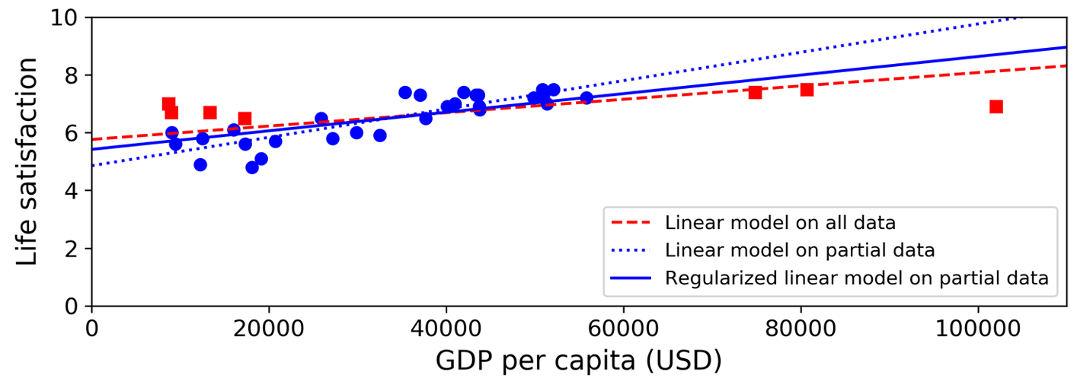
Regularization
Constraining a model to make it simpler and reduce the risk of overfitting is called regularization
The amount of regularization to apply during learning can be controlled by a hyperparameter

Slide 11
Underfitting the Training Data
Underfitting is the opposite of overfitting: it occurs when your model is too simple to learn the underlying structure of the data.
It means that the training accuracy is not good enough.
Here are the main options for fixing this problem:
Select a more powerful model, with more parameters.
Feed better features to the learning algorithm (feature engineering).
Reduce the constraints on the model (e.g., reduce the regularization hyperparameter).

Slide 12
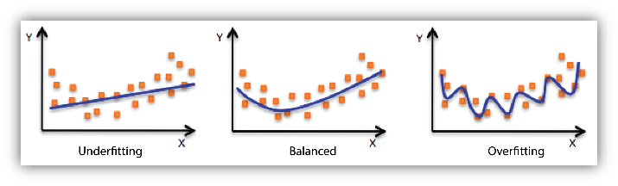
Underfitting vs. Overfitting

Slide 13
References
Hands-On Machine Learning with Scikit-Learn, Keras, and TensorFlow by Aurélien Géron, Copyright © 2019 Kiwisoft S.A.S. All rights reserved.
https://rivery.io/blog/big-data-statistics-how-much-data-is-there-in-the-world/
https://www.deeplearning.ai/courses/machine-learning-specialization/

